Slide 1


Text Analytics
Tushar (MLGeeks)
5-10-2022

Slide 2

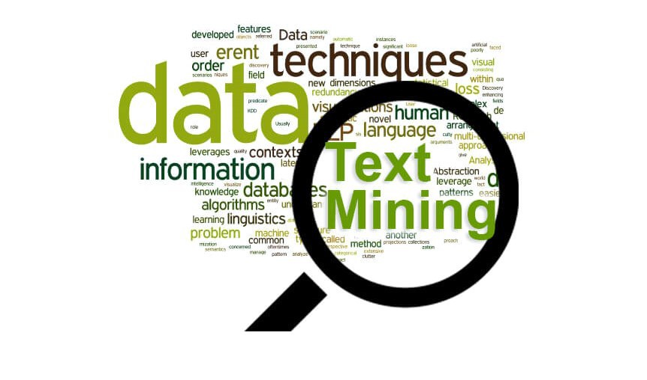
Objectives
Understand types of Text Data
Challenges with Text Data processing
Steps in Text Data preprocessing
Document Term Matrix/Term Document Matrix
Sentiment Analysis
Cosine Similarity

Slide 3
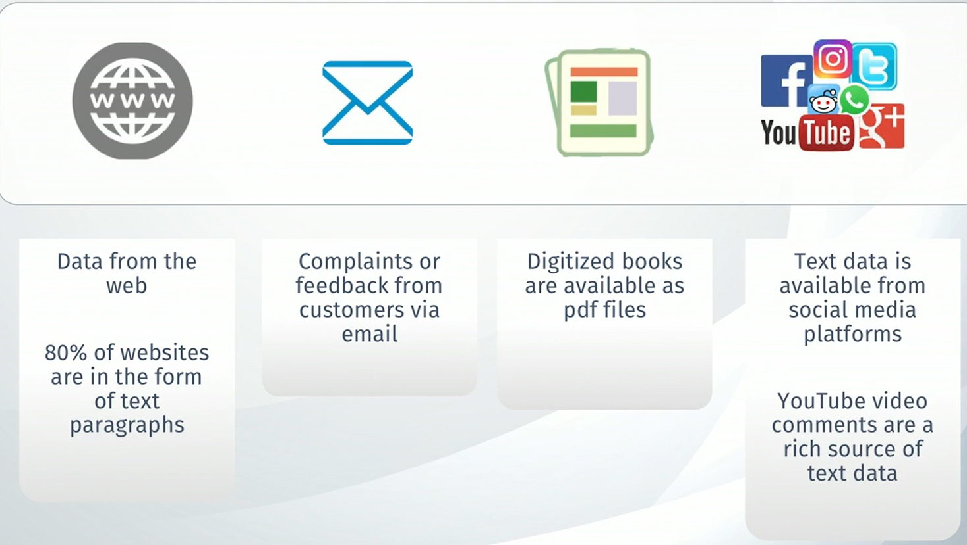
Sources of Text Data

Slide 4
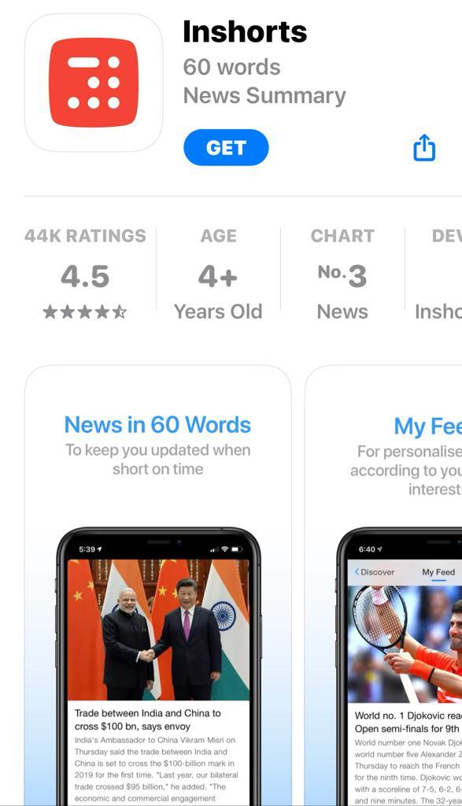

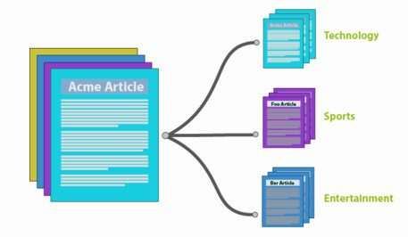

Common Applications
Sentiment Analysis

Slide 5
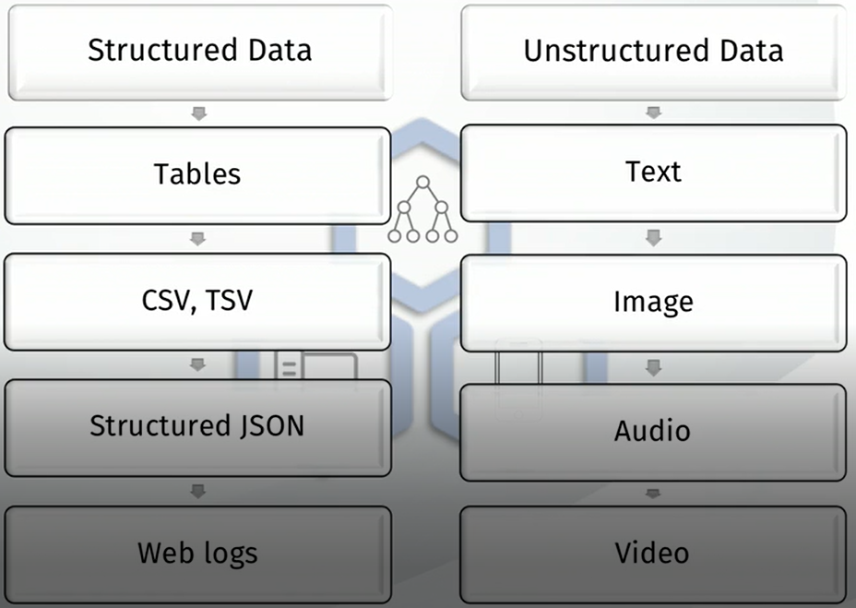
Types of Text Data

Slide 6
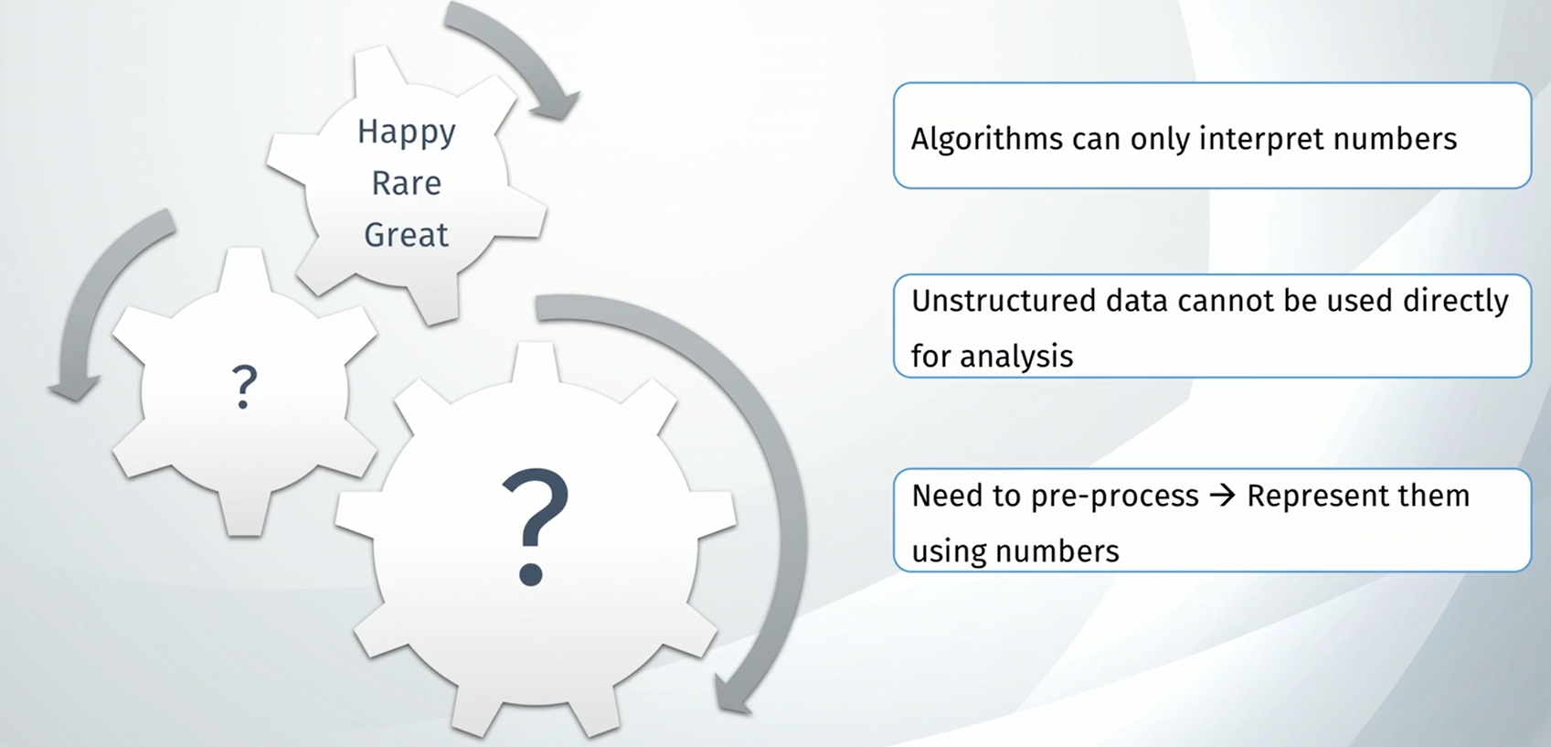
Challenges

Slide 7
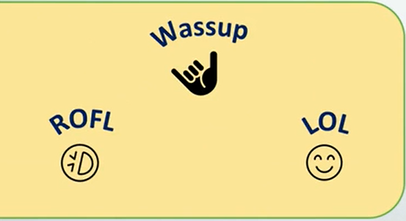
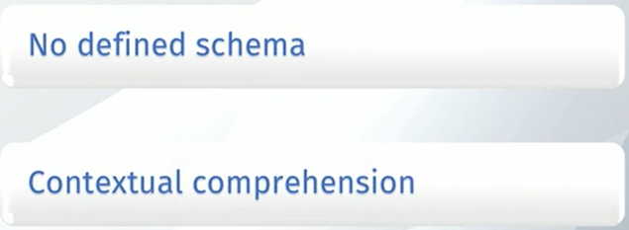



Challenges

Slide 8
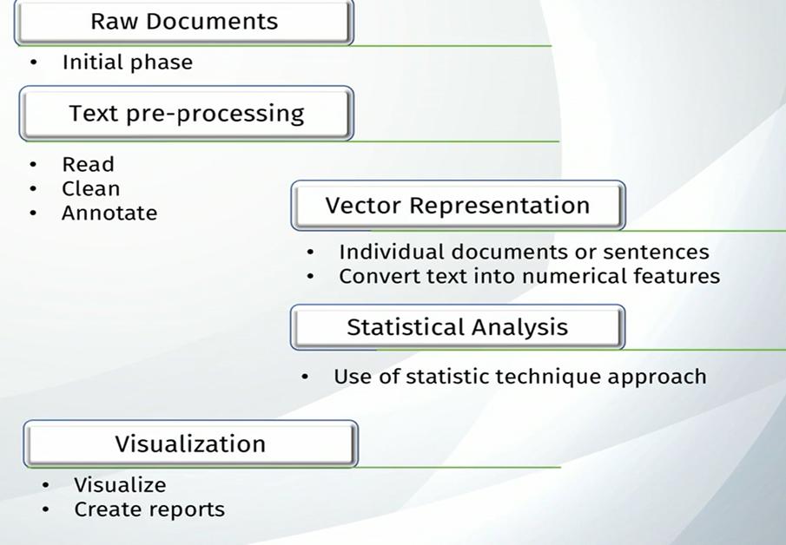
Text Data Processing

Slide 9
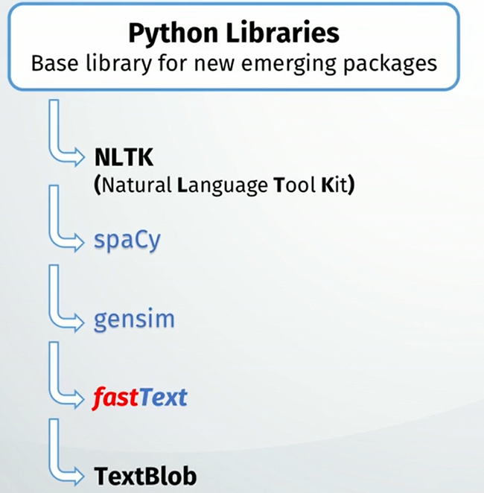
Important Python Modules for Text Analytics

Slide 10
Recap
Types of Data ?
2. Common Applications based on Text Analytics ?
3. Important python library for Text Analytics
A) NLTK B) Dictionary C) CNN D) Pickle

Slide 11
Dataset
A XYZ company wants to understand the employee's sentiment over the company as they found employee attrition in the last one year increased compared to previous years.
Collating the feedbacks in the form of reviews and online surveys in text formats to measure the Employee sentiment towards the company in areas related to -Company infrastructure, leadership, benefits like health care, family events etc.
Also collected employee satisfaction towards promotions, hikes, salaries, Career growth, up-skilling, and work culture.

